Slide 1
CS221: Algorithms and Data Structures Lecture #1 Complexity Theory and Asymptotic Analysis
Steve Wolfman
2014W1
Notes:
TODO (future terms): update the term

Slide 2
Today’s Outline
Programming Project #1 and Forming Teams
Brief Proof Reminder
Asymptotic Analysis, Briefly
Silicon Downs and the SD Cheat Sheet
Asymptotic Analysis, Proofs and Programs
Examples and Exercises

Slide 3
Prog Proj #1 & Teams
Notes:
Some people have had some trouble finding team members, and some people do not have much experience with UNIX and g++, so I want to work on forming some teams right now.

Slide 4
Proof by...
Counterexample
show an example which does not fit with the theorem
QED (the theorem is disproven)
Contradiction
assume the opposite of the theorem
derive a contradiction
QED (the theorem is proven)
Induction
prove for one or more base cases (e.g., n = 1)
assume for one or more anonymous values (e.g., k)
prove for the next value (e.g., k + 1)
QED
Notes:
One of the things we’ll need to do in this class is prove correctness and time bounds. In order to do that, we need methods of proof.

Slide 5
Example Proof by Induction
A number is divisible by 3 iff the sum of its digits is divisible by three
Next: def’ns.
Notes:
X1x2x3x4…xn SD(x)
x % 3 = SD(x) % 3
tack on digit at end
10 % 3 = 1
Good way to convince them that multiplying by 10 mod 3 is the same as multiplying by 1 mod 3:
10x mod 3 = (3 + 3 + 3 + 1)x mod 3 = 3x + 3x + 3x + x mod 3
Obviously, adding something that’s divisible by 3 doesn’t change anything so:
= x mod 3

Slide 6
Example Proof by Induction (Worked)
“A number is divisible by 3 iff the sum of its digits is divisible by three.”
First, some definitions:
Consider a positive integer x to be made up of its n digits: x₁x₂x₃..x_{n}.
For convenience, let’s say SD(x) =
Next: stronger property
Notes:
X1x2x3x4…xn SD(x)
x % 3 = SD(x) % 3
tack on digit at end
10 % 3 = 1
Good way to convince them that multiplying by 10 mod 3 is the same as multiplying by 1 mod 3:
10x mod 3 = (3 + 3 + 3 + 1)x mod 3 = 3x + 3x + 3x + x mod 3
Obviously, adding something that’s divisible by 3 doesn’t change anything so:
= x mod 3

Slide 7
Example Proof by Induction (Worked)
“A number is divisible by 3 iff the sum of its digits is divisible by three.”
There are many ways to solve this, here’s one.
We’ll prove a somewhat stronger property, that for a non-negative integer x with any positive integral number of digits n, SD(x) ≡ x (mod 3).
(That is, the remainder when we divide SD(x) by 3 is the same as the remainder when we divide x by 3.)
Next: insight
Notes:
X1x2x3x4…xn SD(x)
x % 3 = SD(x) % 3
tack on digit at end
10 % 3 = 1
Good way to convince them that multiplying by 10 mod 3 is the same as multiplying by 1 mod 3:
10x mod 3 = (3 + 3 + 3 + 1)x mod 3 = 3x + 3x + 3x + x mod 3
Obviously, adding something that’s divisible by 3 doesn’t change anything so:
= x mod 3

Slide 8
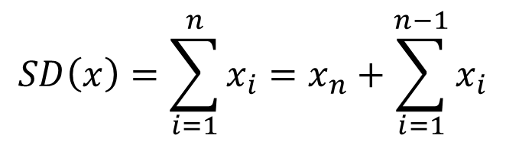
Example Proof by Induction (INSIGHT FIRST!)
How do we break a problem down?
We often break sums down by “pulling off” the first or last term:
We can “peel off” the rightmost or leftmost digit. Peeling off the rightmost is like dividing by 10 (dumping the remainder). Peeling off the leftmost is harder to describe.
Let’s try peeling off the rightmost digit!
Notes:
X1x2x3x4…xn SD(x)
x % 3 = SD(x) % 3
tack on digit at end
10 % 3 = 1
Good way to convince them that multiplying by 10 mod 3 is the same as multiplying by 1 mod 3:
10x mod 3 = (3 + 3 + 3 + 1)x mod 3 = 3x + 3x + 3x + x mod 3
Obviously, adding something that’s divisible by 3 doesn’t change anything so:
= x mod 3

Slide 9
Example Proof by Induction (Worked)
Following our insight, we only need one base case.
Base case (where n = 1):
Consider any number x with one digit (0-9).
SD(x) = = x₁ = x.
So, it’s trivially true that SD(x) ≡ x (mod 3).
Notes:
X1x2x3x4…xn SD(x)
x % 3 = SD(x) % 3
tack on digit at end
10 % 3 = 1
Good way to convince them that multiplying by 10 mod 3 is the same as multiplying by 1 mod 3:
10x mod 3 = (3 + 3 + 3 + 1)x mod 3 = 3x + 3x + 3x + x mod 3
Obviously, adding something that’s divisible by 3 doesn’t change anything so:
= x mod 3

Slide 10
Example Proof by Induction (Worked)
Following our insight, we’ll break a problem of size n into a problem of size n-1. So, we need to assume our theorem holds for size n-1.
WLOG, let n be an arbitrary integer greater than 1.
Induction Hypothesis: Assume for any non-negative integer x with n-1 digits: SD(x) ≡ x (mod 3).
Inductive step:
…
Notes:
X1x2x3x4…xn SD(x)
x % 3 = SD(x) % 3
tack on digit at end
10 % 3 = 1
Good way to convince them that multiplying by 10 mod 3 is the same as multiplying by 1 mod 3:
10x mod 3 = (3 + 3 + 3 + 1)x mod 3 = 3x + 3x + 3x + x mod 3
Obviously, adding something that’s divisible by 3 doesn’t change anything so:
= x mod 3

Slide 11
Example Proof by Induction (Worked)
Following our insight, we now just need to break the problem down as we figured out it breaks down…
IH: Assume for integer x with n-1 digits: SD(x) ≡ x (mod 3).
Inductive step:
Consider an arbitrary number y with n digits.
We can think of y as being made up of its digits: y₁y₂…y_{n-1}y_{n}. Clearly, y₁y₂…y_{n-1} (which we’ll call z) is itself an n-1 digit number; so, the induction hypothesis applies:
SD(z) ≡ z (mod 3).
Notes:
X1x2x3x4…xn SD(x)
x % 3 = SD(x) % 3
tack on digit at end
10 % 3 = 1
Good way to convince them that multiplying by 10 mod 3 is the same as multiplying by 1 mod 3:
10x mod 3 = (3 + 3 + 3 + 1)x mod 3 = 3x + 3x + 3x + x mod 3
Obviously, adding something that’s divisible by 3 doesn’t change anything so:
= x mod 3

Slide 12
Example Proof by Induction (Worked)
Inductive step continued:
Now, note that y = z*10 + y_{n}.
So: y ≡ (z*10 + y_{n}) (mod 3)
≡ (z*9 + z + y_{n}) (mod 3)
z*9 is divisible by 3; so, it has no impact on the remainder of the quantity when divided by 3:
≡ (z + y_{n}) (mod 3)
Notes:
X1x2x3x4…xn SD(x)
x % 3 = SD(x) % 3
tack on digit at end
10 % 3 = 1
Good way to convince them that multiplying by 10 mod 3 is the same as multiplying by 1 mod 3:
10x mod 3 = (3 + 3 + 3 + 1)x mod 3 = 3x + 3x + 3x + x mod 3
Obviously, adding something that’s divisible by 3 doesn’t change anything so:
= x mod 3

Slide 13
Example Proof by Induction (Worked)
Inductive step continued:
By the IH, we know SD(z) ≡ z (mod 3).
So:
≡ (z + y_{n}) (mod 3)
≡ (SD(z) + y_{n}) (mod 3)
≡ (y₁ + y₂ + … + y_{n-1} + y_{n}) (mod 3)
≡ SD(y) (mod 3)
QED!
Can I really sub SD(z) for z inside the mod, even though they’re only equal mod 3?
Yes… they only differ by a multiple of 3, which cannot affect the “mod 3” sum.
Notes:
We actually use a property of modular arithmetic that we haven’t proven to do the substitution above (putting SD(z) in for z), but it is a correct property.

Slide 14
Proof by Induction Pattern Reminder
First, find a way to break down the theorem interpreted for some (large-ish, arbitrary) value k in terms of the theorem interpreted for smaller values.
Next, prove any base cases needed to ensure that the “breakdown” done over and over eventually hits a base case.
Then, assume the theorem works for all the “smaller values” you needed in the breakdown (as long as k is larger than your base cases).
Finally, build up from those assumptions to the k case.

Slide 15
Induction Pattern to Prove P(n)
First, figure out how P(n) breaks down in terms of P(something(s) smaller).
P(n) is theorem goes here.
Theorem: P(n) is true for all n ≥ smallest case.
Proof: We proceed by induction on n.
Base Case(s) (P(.) is true for whichever cases you need to “bottom out”): Prove each base case via some (usually easy) proof techniques.
Inductive Step (if P(.) is true for the “something smaller” case(s), then P(n) is true, for all n not covered by the base case (usually: greater than the largest base case)):
WLOG, let n be an arbitrary integer not covered by the base case (usually: greater than the largest base case).
Assume P(.) is true for the “something smaller” case(s). (The Induction Hyothesis (IH).)
Break P(n) down in terms of the smaller case(s).
The smaller cases are true, by the IH.
Build back up to show that P(n) is true.
This completes our induction proof. QED

Slide 16
Today’s Outline
Programming Project #1 and Forming Teams
Brief Proof Reminder
Asymptotic Analysis, Briefly
Silicon Downs and the SD Cheat Sheet
Asymptotic Analysis, Proofs and Programs
Examples and Exercises

Slide 17
A Task to Solve and Analyze
Find a student’s name in a class given her student ID
Ask for solutions; good ones:
- List of IDs
Ordered list of ids
Array of all IDs
Hash table/map
Discuss comparing perf (wall-clock time, memory use, disk accesses, power, etc.)
Generalize across machines/instances/instance sizes?
Notes:
Let’s try some solutions to this:
List of Ids
Ordered list of Ids
Array of all possible IDs
Issues to address:
How do we compare performance? (Pull out things like wall-clock time, network traffic, etc.)
How do we generalize our comparison across computers and input sizes?
Specifically, what does an input size MEAN when there can be many inputs of a given size?

Slide 18
Analysis of Algorithms
Analysis of an algorithm gives insight into how long the program runs and how much memory it uses
time complexity
space complexity
Analysis can provide insight into alternative algorithms
Input size is indicated by a number n (sometimes there are multiple inputs)
Running time is a function of n (Z⁰ → R⁰) such as
T(n) = 4n + 5
T(n) = 0.5 n log n - 2n + 7
T(n) = 2^{n} + n³ + 3n
But...
Notes:
In the most general sense, input size is the number of bits required to describe the input. Not clear it’s worthwhile to make that distinction here, however.
In general, we’ll use analysis of algorithms to determine just this sort of thing. Time and space tradeoffs.
We’ll also use the analyses to see how we can improve our algorithms.
Here’s a general sketch of what an analysis will look like.

Slide 19
Asymptotic Analysis Hacks
Eliminate low order terms
4n + 5 ⇒ 4n
0.5 n log n - 2n + 7 ⇒ 0.5 n log n
2^{n} + n³ + 3n ⇒ 2^{n}
Eliminate coefficients
4n ⇒ n
0.5 n log n ⇒ n log n
n log (n²) = 2 n log n ⇒ n log n
Notes:
We didn’t get very precise in our analysis of the ID info finder; why?
Didn’t know the machine we’d use.
Is this always true? Do you buy that coefficients and low order terms don’t matter?
When might they matter?
(Linked list memory usage)

Slide 20
Rates of Growth
Suppose a computer executes 10¹² ops per second:
10⁴s = 2.8 hrs 10¹⁸s = 30 billion years
Pie seconds
Notes:
On the other hand, the high order terms will tend to dominate given enough input. Here’s a chart of how quickly a computer can finish various algorithms according to their runtime.
There are “pie seconds” in a nanocentury. Roughly 3.14 seconds in one billionth of a century.

Slide 21
Order Notation
T(n) ∈ O(f(n)) if there are constants c and n₀ such that T(n) ≤ c f(n) for all n ≥ n₀
Notes:
We’ll use some specific terminology to describe asymptotic behavior.
There are some analogies here that you might find useful.

Slide 22
One Way to Think About Big-O
T(n)
Time
(or anything else we can measure)
We want to compare the “overall” runtime (or memory usage or …) of a piece of code against a familiar, simple function.
f(n)
Input size
T(n) ∈ O(f(n)) if there are constants c and n₀ such that T(n) ≤ c f(n) for all n ≥ n₀
Notes:
TAs suggested this style of approach in 2011W2 after talking with students in midterm office hours prep.

Slide 23
One Way to Think About Big-O
T(n)
Time
(or anything else we can measure)
We (usually) do not measure in any particular unit; so, we get to scale up our comparison function if need be.
f(n)
c f(n)
Input size
T(n) ∈ O(f(n)) if there are constants c and n₀ such that T(n) ≤ c f(n) for all n ≥ n₀

Slide 24
One Way to Think About Big-O
c f(n)
T(n)
Time
(or anything else we can measure)
We do want the comparison to be valid for all sufficiently large inputs… but we’re willing to ignore behaviour on small examples. (Looking for “steady state”.)
f(n)
n₀
Input size
T(n) ∈ O(f(n)) if there are constants c and n₀ such that T(n) ≤ c f(n) for all n ≥ n₀

Slide 25
One Way to Think About Big-O
c f(n)
T(n)
Time
(or anything else we can measure)
Given all that, T(n) should be less than (the adjusted version of) f(n):
f(n)
n₀
Input size
T(n) ∈ O(f(n)) if there are constants c and n₀ such that T(n) ≤ c f(n) for all n ≥ n₀

Slide 26
Order Notation
T(n) ∈ O(f(n)) if there are constants c and n₀ such that T(n) ≤ c f(n) for all n ≥ n₀
T(n) ∈ Ω (f(n)) if f(n) ∈ O(T(n))
T(n) ∈ Θ(f(n)) if T(n) ∈ O(f(n)) and T(n) ∈ Ω (f(n))
Analogy to <=, >=, =
Notes:
We’ll use some specific terminology to describe asymptotic behavior.
There are some analogies here that you might find useful.
2010W2, dropped these INCORRECT definitions (e.g., n vs. n|sin n|, is not o nor theta)
T(n) ∈o(f(n)) if T(n) ∈ O(f(n)) and T(n) ∉ Θ(f(n))
T(n) ∈ω(f(n)) if T(n) ∈ O(f(n)) and T(n) ∉ Θ(f(n))

Slide 27
One Way to Think About Big-Ω
T(n)
Time
(or anything else we can measure)
We want to compare the “overall” runtime (or memory usage or …) of a piece of code against a familiar, simple function, this time getting a lower-bound.
f(n)
Input size
T(n) ∈ Ω(f(n)) if there are constants d and n₀ such that T(n) ≥ d f(n) for all n ≥ n₀

Slide 28
One Way to Think About Big-Ω
T(n)
Time
(or anything else we can measure)
Given the same sort of adjustments, T(n) should be greater than (the adjusted version of) f(n):
f(n)
d f(n)
n₀
Input size
T(n) ∈ Ω(f(n)) if there are constants c and n₀ such that T(n) ≥ d f(n) for all n ≥ n₀

Slide 29
One Way to Think About Big-Θ
c f(n)
T(n)
Time
(or anything else we can measure)
Given the same sort of adjustments, T(n) should be between than the adjusted versions of f(n):
f(n)
d f(n)
n₀
Input size
T(n) ∈ Θ(f(n)) if ∃ c, d and n₀ such that d f(n) ≤ T(n) ≤ c f(n) for all n ≥ n₀

Slide 30
Order Notation
T(n) ∈ O(f(n)) if there are constants c and n₀ such that T(n) ≤ c f(n) for all n ≥ n₀
T(n) ∈ Ω (f(n)) if f(n) ∈ O(T(n))
T(n) ∈ Θ(f(n)) if T(n) ∈ O(f(n)) and T(n) ∈ Ω (f(n))
How would you prove one of these?
Prove O(..) by finding a good c and n₀ (often helps in scratch work to “solve for” c, keeping notes of constraints on n).
Then, assume n ≥ n₀ and show that T(n) ≤ c f(n).
Prove Ω and Θ by breaking down in terms of O.
Notes:
We’ll use some specific terminology to describe asymptotic behavior.
There are some analogies here that you might find useful.
2010W2, dropped these INCORRECT definitions (e.g., n vs. n|sin n|, is not o nor theta)
T(n) ∈o(f(n)) if T(n) ∈ O(f(n)) and T(n) ∉ Θ(f(n))
T(n) ∈ω(f(n)) if T(n) ∈ O(f(n)) and T(n) ∉ Θ(f(n))

Slide 31
Examples
10,000 n² + 25 n ∈ Θ(n²)
10⁻¹⁰ n² ∈ Θ(n²)
n log n ∈ O(n²)
n log n ∈ Ω(n)
n³ + 4 ∈ O(n⁴) but not Θ(n⁴)
n³ + 4 ∈ Ω(n²) but not Θ(n²)

Slide 32
Today’s Outline
Programming Project #1 and Forming Teams
Brief Proof Reminder
Asymptotic Analysis, Briefly
Silicon Downs and the SD Cheat Sheet
Asymptotic Analysis, Proofs and Programs
Examples and Exercises

Slide 33
Silicon Downs
Post #1
n³ + 2n²
n^{0.1}
n + 100n^{0.1}
5n⁵
n⁻¹⁵2^{n}/100
8^{2lg n}
mn³
Post #2
100n² + 1000
log n
2n + 10 log n
n!
1000n¹⁵
3n⁷ + 7n
2^{m}n
For each race, which “horse” is “faster”. Note that faster means smaller, not larger!
Left
Right
Tied
It depends
I am opposed to algorithm racing.
Notes:
Welcome, everyone, to the Silicon Downs. I’m getting race results as we stand here.
Let’s start with the first race. I’ll have the first row bet on race #1. Raise your hand if you bet on function #1 (the jockey is n^0.1)
So on.
Show the race slides after each race.

Slide 34
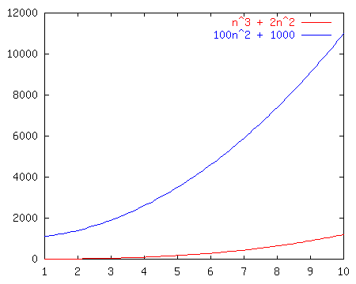
Race I
Left
Right
Tied
It depends
n³ + 2n²
vs.
100n² + 1000

Slide 35
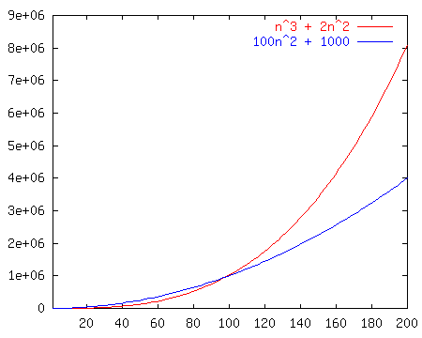
Race I
Left
Right
Tied
It depends
n³ + 2n²
vs.
100n² + 1000

Slide 36
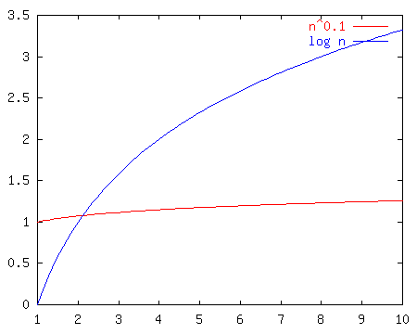
Race II
Left
Right
Tied
It depends
n^{0.1}
vs.
log n
Notes:
Well, log n looked good out of the starting gate and indeed kept on looking good until about n^17 at which point n^0.1 passed it up forever.
Moral of the story? N^epsilon beats log n for any eps > 0. BUT, which one of these is really better?

Slide 37
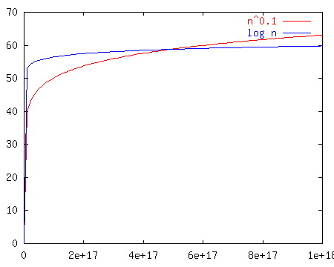
Race II
Left
Right
Tied
It depends
n^{0.1}
vs.
log n
Notes:
Well, log n looked good out of the starting gate and indeed kept on looking good until about n^17 at which point n^0.1 passed it up forever.
Moral of the story? N^epsilon beats log n for any eps > 0. BUT, which one of these is really better?

Slide 38
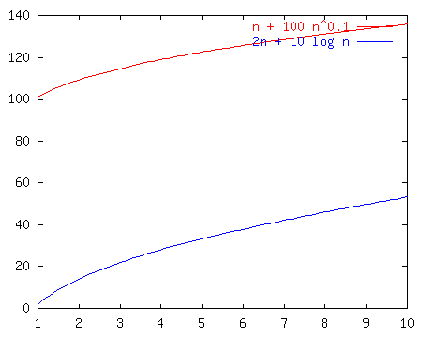
Race III
Left
Right
Tied
It depends
n + 100n^{0.1}
vs.
2n + 10 log n
Notes:
Notice that these just look like n and 2n once we get way out. That’s because the larger terms dominate. So, the left is less, but not asymptotically less.
It’s a TIE!

Slide 39
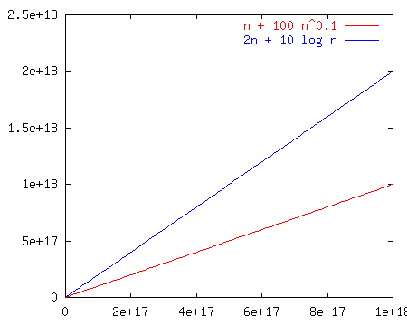
Race III
Left
Right
Tied
It depends
n + 100n^{0.1}
vs.
2n + 10 log n
Discuss WHY a tie.
(counting what? What kind of machine?)
Notes:
Notice that these just look like n and 2n once we get way out. That’s because the larger terms dominate. So, the left is less, but not asymptotically less.
It’s a TIE!

Slide 40
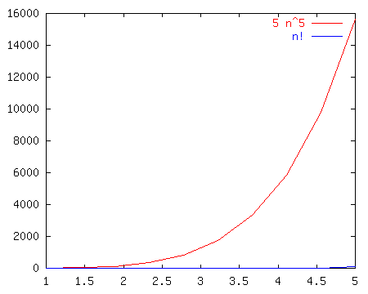
Race IV
Left
Right
Tied
It depends
5n⁵
vs.
n!
Notes:
N! is BIG!!!

Slide 41
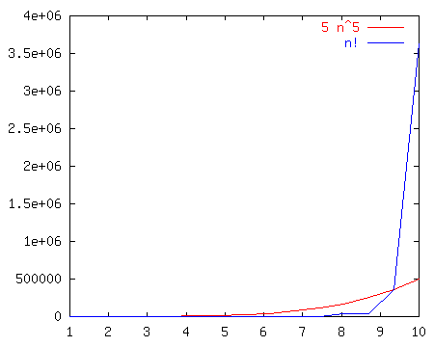
Race IV
Left
Right
Tied
It depends
5n⁵
vs.
n!
Notes:
N! is BIG!!!

Slide 42
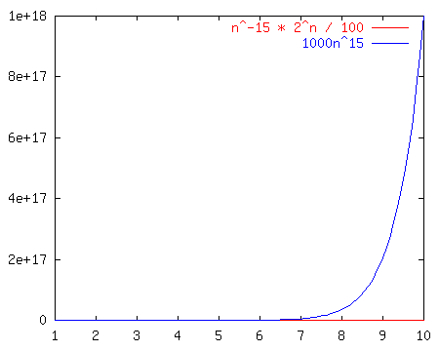
Race V
Left
Right
Tied
It depends
n⁻¹⁵2^{n}/100
vs.
1000n¹⁵
Notes:
No matter how you put it, any exponential beats any polynomial. It doesn’t even take that long here (~250 input size)

Slide 43
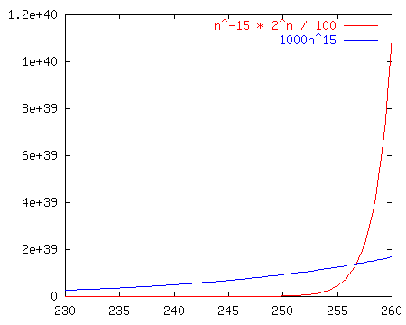
Race V
Left
Right
Tied
It depends
n⁻¹⁵2^{n}/100
vs.
1000n¹⁵
Notes:
No matter how you put it, any exponential beats any polynomial. It doesn’t even take that long here (~250 input size)

Slide 44
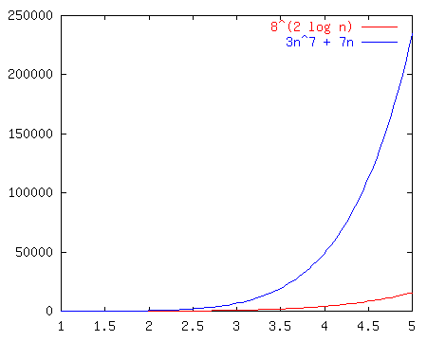
Race VI
Left
Right
Tied
It depends
8^{2lg(n)}
vs.
3n⁷ + 7n
Log analysis on left one.
No next slide.
Notes:
We can reduce the left hand term to n^6, so they’re both polynomial and it’s an open and shut case.

Slide 45
Race VII
Left
Right
Tied
It depends
mn³
vs.
2^{m}n
No graphs. Really about
What this means.
Notes:
IT DEPENDS!!!

Slide 46
Silicon Downs
Post #1
n³ + 2n²
n^{0.1}
n + 100n^{0.1}
5n⁵
n⁻¹⁵2^{n}/100
8^{2lg n}
mn³
Post #2
100n² + 1000
log n
2n + 10 log n
n!
1000n¹⁵
3n⁷ + 7n
2^{m}n
Winner
O(n²)
O(log n)
TIE O(n)
O(n⁵)
O(n¹⁵)
O(n⁶)
IT DEPENDS
Notes:
Welcome, everyone, to the Silicon Downs. I’m getting race results as we stand here.
Let’s start with the first race. I’ll have the first row bet on race #1. Raise your hand if you bet on function #1 (the jockey is n^0.1)
So on.
Show the race slides after each race.

Slide 47
Mounties Find Silicon Downs Fixed
The fix sheet (typical growth rates in order)
constant: O(1)
logarithmic: O(log n) (log_{k}n, log (n²) ∈ O(log n))
poly-log: O((log n)^{k})
linear: O(n)
log-linear: O(n log n)
superlinear: O(n^{1+c}) (c is a constant > 0)
quadratic: O(n²)
cubic: O(n³)
polynomial: O(n^{k}) (k is a constant)
exponential: O(c^{n}) (c is a constant > 1)
note: even a tiny power “beats” a log
“tractable”
“intractable”
Notes:
Well, it turns out that the old Silicon Downs is fixed. They dope up the horses to make the first few laps interesting, but we can always find out who wins.
Here’s a chart comparing some of the functions. Notice that any exponential beats any polynomial.
Any superlinear beats any poly-log-linear.
Also keep in mind (though I won’t show it) that sometimes the input has more than one parameter. Like if you take in two strings. In that case you need to be very careful about what is constant and what can be ignored.
O(log m + 2^{n}) is not necessarily O(2^{n})

Slide 48
The VERY Fixed Parts
There’s also a notion of asymptotic “dominance”, which means one function as a fraction of another (asymptotically dominant) function goes to zero.
Each line below dominates the one above it:
O(1)
O(log^{k} n), where k > 0
O(n^{c}), where 0 < c < 1
O(n)
O(n (log n)^{k}), where k > 0
O(n^{1+c}), where 0 < c < 1
O(n^{k}), where k ≥ 2 (the rest of the polynomials)
O(c^{n}), where c > 1

Slide 49
USE those cheat sheets!
Which is faster, n³ or n³ log n?
(Hint: try dividing one by the other.)
Which is faster, n³ or n^{3.01}/log n?
^{(Ditto the hint above!)}
Notes:
People didn’t really get the use of this in 2009W1. Stressing more here.

Slide 50
Today’s Outline
Programming Project #1 and Forming Teams
Brief Proof Reminder
Asymptotic Analysis, Briefly
Silicon Downs and the SD Cheat Sheet
Asymptotic Analysis, Proofs and Programs
Examples and Exercises

Slide 51
Terminology (Reminder)
Given an algorithm whose running time is T(n)
T(n) ∈ O(f(n)) if there are constants c and n₀ such that T(n) ≤ c f(n) for all n ≥ n₀
T(n) ∈ Ω (f(n)) if f(n) ∈ O(T(n))
T(n) ∈ Θ(f(n)) if T(n) ∈ O(f(n)) and T(n) ∈ Ω (f(n))
Notes:
OK, here’s how we’ll talk about these things.
You’ve probably seen O(n) before. Here’s how we define it. There’s some value and some scaling factor after which f(n) beats T(n) forever.
Similarly, omega(n),…
There’s an analogy here that you might find useful. These terms are sort of like inequalities:
O --> <=
o --> <
Omega --> >=
omega --> >
theta --> =
These are “dominance” comparisons, and many of the properties of normal comparisons hold.
2009W1, included:
T(n) ∈ o(f(n)) if T(n) ∈ O(f(n)) and T(n) ∉ Θ(f(n))
1, log n, n^{0.99} ∈ o(n)
T(n) ∈ ω(f(n)) if T(n) ∈ O(f(n)) and T(n) ∉ Θ(f(n))
n^{1.01}, n², 100 . 2^{n}, n³ log n ∈ ω(n)

Slide 52
Types of analysis
Orthogonal axes
bound flavor
upper bound (O)
lower bound (Ω): especially useful for problems
asymptotically tight (Θ)
analysis case
worst case (adversary)
average case
best case
“common” case
analysis quality
loose bound (any true analysis)
tight bound (no better “meaningful” bound that is asymptotically different)
| x² sin x | + x
No especially “meaningful” tight bound.
I might say “no tight bound” even though that’s technically untrue.
Notes:
We already discussed the bound flavor. All of these can be applied to any analysis case. For example, we’ll later prove that sorting in the worst case takes at least n log n time. That’s a lower bound on a worst case.
Note there’s two senses of tight. I’ll try to avoid the terminology “asymptotically tight” and stick with the lower def’n of tight. O(inf) is not tight!

Slide 53
Analyzing Code
C++ operations - constant time
consecutive stmts - sum of times
conditionals - sum of branches, condition
loops - sum of iterations
function calls - cost of function body
We don’t know just how long each operation will take on each machine.
So, we try to figure out which operations will:
definitely run quickly (less than some constant limit).
have runtimes dependent on inputs
really matter to our algorithm
Notes:
Alright, I want to do some code examples, but first, how will we examine code?
These are just rules of thumb, not the way you always do it.
Sometimes, for ex, it’s important to keep track of which branch of a conditional is followed when (like when analyzing recursive functions).

Slide 54
Analyzing Code
// Linear search
find(key, array)
for i = 1 to length(array) do
if array[i] == key
return i
return -1
Step 1: What’s the input size n?
Need to do this myself.
NOT FAIR to have students do it.
BUT, they should work along!
DO ALL STEPS HERE:
Input size; analysis type; cost per line; T(n) “raw”; T(n) asymptotic + frivolity + proof
Notes:
How do we analyze this? How long does it take? It depends on the input, right?
Talk about the problems with average case here…
Average case is hard! What does “average” mean. For example, what’s the average case for searching an unordered list (as precise as possible, not asymptotic).
WRONG (maybe)! It’s about n, not 1/2 n. Why? You have to search the whole thing if the elt is not there.

Slide 55
Analyzing Code
// Linear search
find(key, array)
for i = 1 to length(array) do
if array[i] == key
return i
return -1
Step 2: What kind of analysis should we perform? Worst-case? Best-case? Average-case?
Expected-case, amortized, …
Notes:
How do we analyze this? How long does it take? It depends on the input, right?
Talk about the problems with average case here…
Average case is hard! What does “average” mean. For example, what’s the average case for searching an unordered list (as precise as possible, not asymptotic).
WRONG (maybe)! It’s about n, not 1/2 n. Why? You have to search the whole thing if the elt is not there.

Slide 56
Analyzing Code
// Linear search
find(key, array)
for i = 1 to length(array) do
if array[i] == key
return i
return -1
Step 3: How much does each line cost? (Are lines the right unit?)
Notes:
How do we analyze this? How long does it take? It depends on the input, right?
Talk about the problems with average case here…
Average case is hard! What does “average” mean. For example, what’s the average case for searching an unordered list (as precise as possible, not asymptotic).
WRONG (maybe)! It’s about n, not 1/2 n. Why? You have to search the whole thing if the elt is not there.

Slide 57
Analyzing Code
// Linear search
find(key, array)
for i = 1 to length(array) do
if array[i] == key
return i
return -1
Step 4: What’s T(n) in its raw form?
Notes:
How do we analyze this? How long does it take? It depends on the input, right?
Talk about the problems with average case here…
Average case is hard! What does “average” mean. For example, what’s the average case for searching an unordered list (as precise as possible, not asymptotic).
WRONG (maybe)! It’s about n, not 1/2 n. Why? You have to search the whole thing if the elt is not there.

Slide 58
Analyzing Code
// Linear search
find(key, array)
for i = 1 to length(array) do
if array[i] == key
return i
return -1
Step 5: Simplify T(n) and convert to order notation. (Also, which order notation: O, Θ, Ω?)
Notes:
How do we analyze this? How long does it take? It depends on the input, right?
Talk about the problems with average case here…
Average case is hard! What does “average” mean. For example, what’s the average case for searching an unordered list (as precise as possible, not asymptotic).
WRONG (maybe)! It’s about n, not 1/2 n. Why? You have to search the whole thing if the elt is not there.

Slide 59
Analyzing Code
// Linear search
find(key, array)
for i = 1 to length(array) do
if array[i] == key
return i
return -1
Step 6: Casually name-drop the appropriate terms in order to sound bracingly cool to colleagues: “Oh, linear search? That’s tractable, polynomial time. What polynomial? Linear, duh. See the name?! I hear it’s sub-linear on quantum computers, though. Wild, eh?”
Notes:
How do we analyze this? How long does it take? It depends on the input, right?
Talk about the problems with average case here…
Average case is hard! What does “average” mean. For example, what’s the average case for searching an unordered list (as precise as possible, not asymptotic).
WRONG (maybe)! It’s about n, not 1/2 n. Why? You have to search the whole thing if the elt is not there.

Slide 60
Analyzing Code
// Linear search
find(key, array)
for i = 1 to length(array) do
if array[i] == key
return i
return -1
Step 7: Prove the asymptotic bound by finding constants c and n₀ such that for all n ≥ n₀, T(n) ≤ cn.
Let c = 4. Let n0 = 1. WLOG, let n be a positive integer such that n >= n0.
3n + 1 <= 3n + n = 4n = cn. QED.
You usually won’t do this in practice.
Notes:
How do we analyze this? How long does it take? It depends on the input, right?
Talk about the problems with average case here…
Average case is hard! What does “average” mean. For example, what’s the average case for searching an unordered list (as precise as possible, not asymptotic).
WRONG (maybe)! It’s about n, not 1/2 n. Why? You have to search the whole thing if the elt is not there.

Slide 61
Today’s Outline
Programming Project #1 and Forming Teams
Brief Proof Reminder
Asymptotic Analysis, Briefly
Silicon Downs and the SD Cheat Sheet
Asymptotic Analysis, Proofs and Programs
Examples and Exercises

Slide 62
More Examples Than You Can Shake a Stick At (#0)
// Linear search
find(key, array)
for i = 1 to length(array) do
if array[i] == key
return i
return -1
Here’s a whack-load of examples for us to:
find a function T(n) describing its runtime
find T(n)’s asymptotic complexity
find c and n₀ to prove the complexity
Notes:
How do we analyze this? How long does it take? It depends on the input, right?
Talk about the problems with average case here…
Average case is hard! What does “average” mean. For example, what’s the average case for searching an unordered list (as precise as possible, not asymptotic).
WRONG (maybe)! It’s about n, not 1/2 n. Why? You have to search the whole thing if the elt is not there.

Slide 63
METYCSSA (#1)
for i = 1 to n do
for j = 1 to n do
sum = sum + 1
Time complexity:
O(n)
O(n lg n)
O(n²)
O(n² lg n)
None of these
Do this one myself.
Notes:
I spent 5 minutes looking at my notes trying to figure out why this 1 was an i when it wasn’t. So, I’m putting variables in blue italics.
This example is pretty straightforward. Each loop goes N times, constant amount of work on the inside.
N*N*1 = O(N^2)

Slide 64
METYCSSA (#2)
i = 1
while i < n do
for j = i to n do
sum = sum + 1
i++
Time complexity:
O(n)
O(n lg n)
O(n²)
O(n² lg n)
None of these
Exercise!
Notes:
There’s a little twist here. J goes from I to N, not 1 to N.
So, let’s do the sums
inside is constant.
Next loop is sum I to N of 1 which equals N - I + 1
Outer loop is sum 1 to N of N - I + 1
That’s the same as
sum N to 1 of I
or N(N+1)/2
or O(N^2)

Slide 65
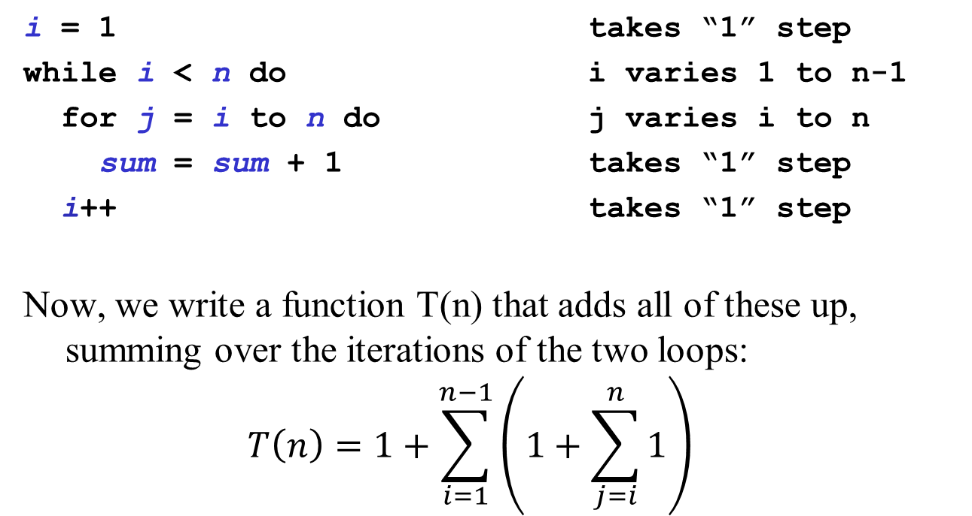
Three METYCSSA2 Approaches: Pure Math
Exercise!
Notes:
There’s a little twist here. J goes from I to N, not 1 to N.
So, let’s do the sums
inside is constant.
Next loop is sum I to N of 1 which equals N - I + 1
Outer loop is sum 1 to N of N - I + 1
That’s the same as
sum N to 1 of I
or N(N+1)/2
or O(N^2)

Slide 66
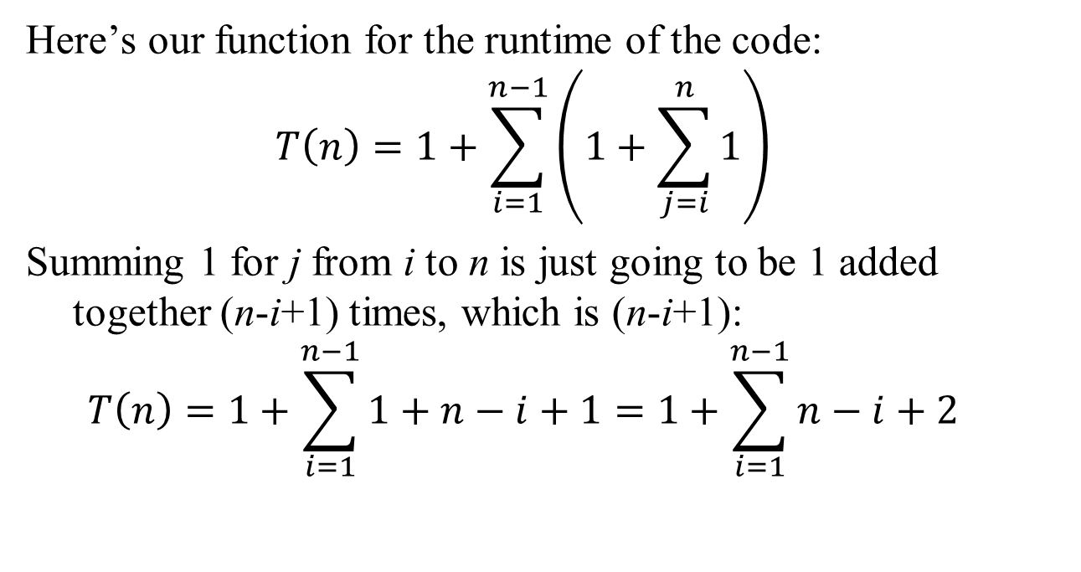
Three METYCSSA2 Approaches: Pure Math
Exercise!
Notes:
There’s a little twist here. J goes from I to N, not 1 to N.
So, let’s do the sums
inside is constant.
Next loop is sum I to N of 1 which equals N - I + 1
Outer loop is sum 1 to N of N - I + 1
That’s the same as
sum N to 1 of I
or N(N+1)/2
or O(N^2)

Slide 67
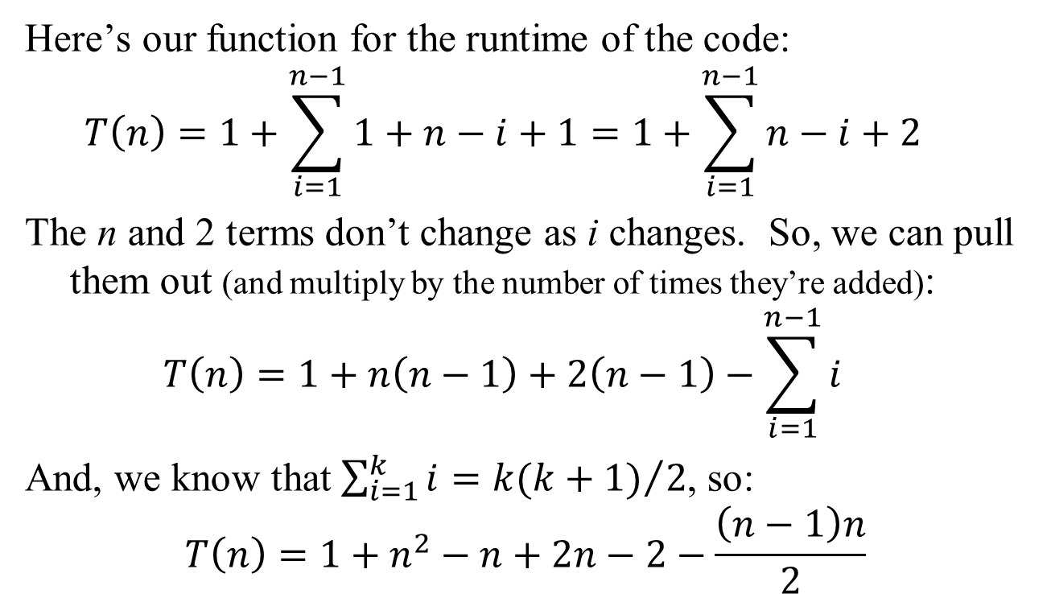
Three METYCSSA2 Approaches: Pure Math
Exercise!
Notes:
There’s a little twist here. J goes from I to N, not 1 to N.
So, let’s do the sums
inside is constant.
Next loop is sum I to N of 1 which equals N - I + 1
Outer loop is sum 1 to N of N - I + 1
That’s the same as
sum N to 1 of I
or N(N+1)/2
or O(N^2)

Slide 68
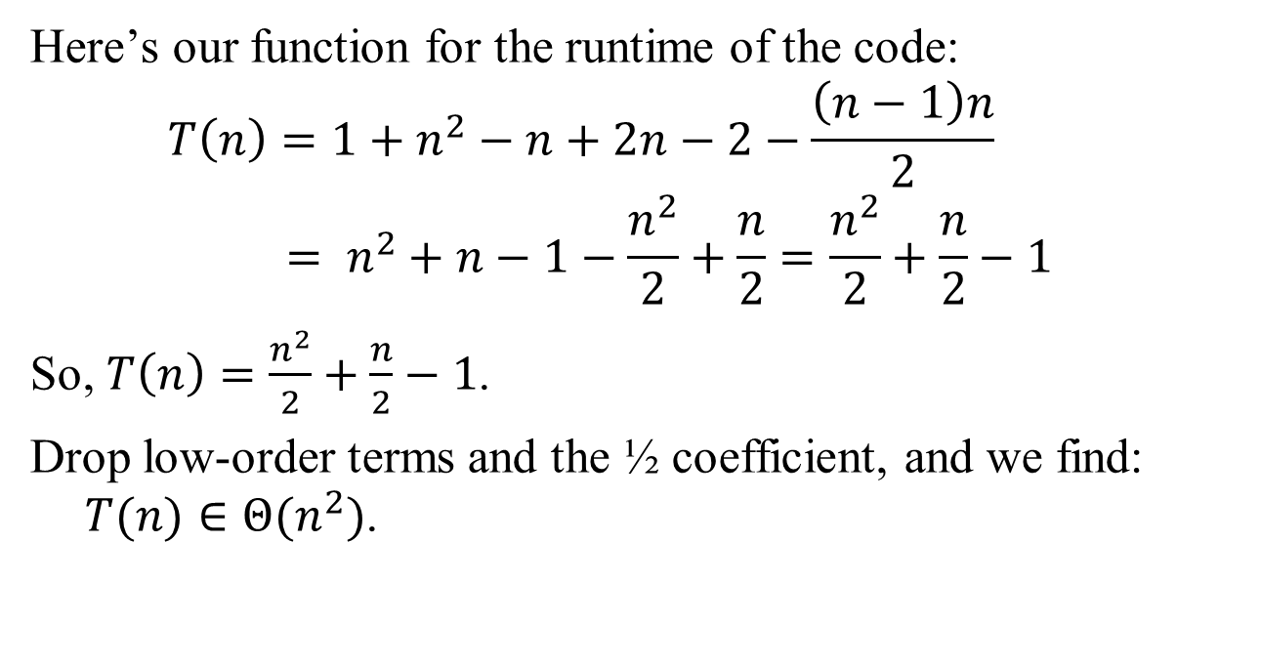
Three METYCSSA2 Approaches: Pure Math
Yay!!!
Exercise!
Notes:
There’s a little twist here. J goes from I to N, not 1 to N.
So, let’s do the sums
inside is constant.
Next loop is sum I to N of 1 which equals N - I + 1
Outer loop is sum 1 to N of N - I + 1
That’s the same as
sum N to 1 of I
or N(N+1)/2
or O(N^2)

Slide 69
Three METYCSSA2 Approaches: Faster Code/Slower Code
i = 1 takes “1” step
while i < n do i varies 1 to n-1
for j = i to n do j varies i to n
sum = sum + 1 takes “1” step
i++ takes “1” step
This code is “too hard” to deal with. So, let’s find just an upper bound.
In which case we get to change the code so in any way that makes it run no faster (even if it runs slower).
We’ll let j go from 1 to n rather than i to n. Since i ≥ 1, this is no less work than the code was already doing…
Exercise!
Notes:
There’s a little twist here. J goes from I to N, not 1 to N.
So, let’s do the sums
inside is constant.
Next loop is sum I to N of 1 which equals N - I + 1
Outer loop is sum 1 to N of N - I + 1
That’s the same as
sum N to 1 of I
or N(N+1)/2
or O(N^2)

Slide 70
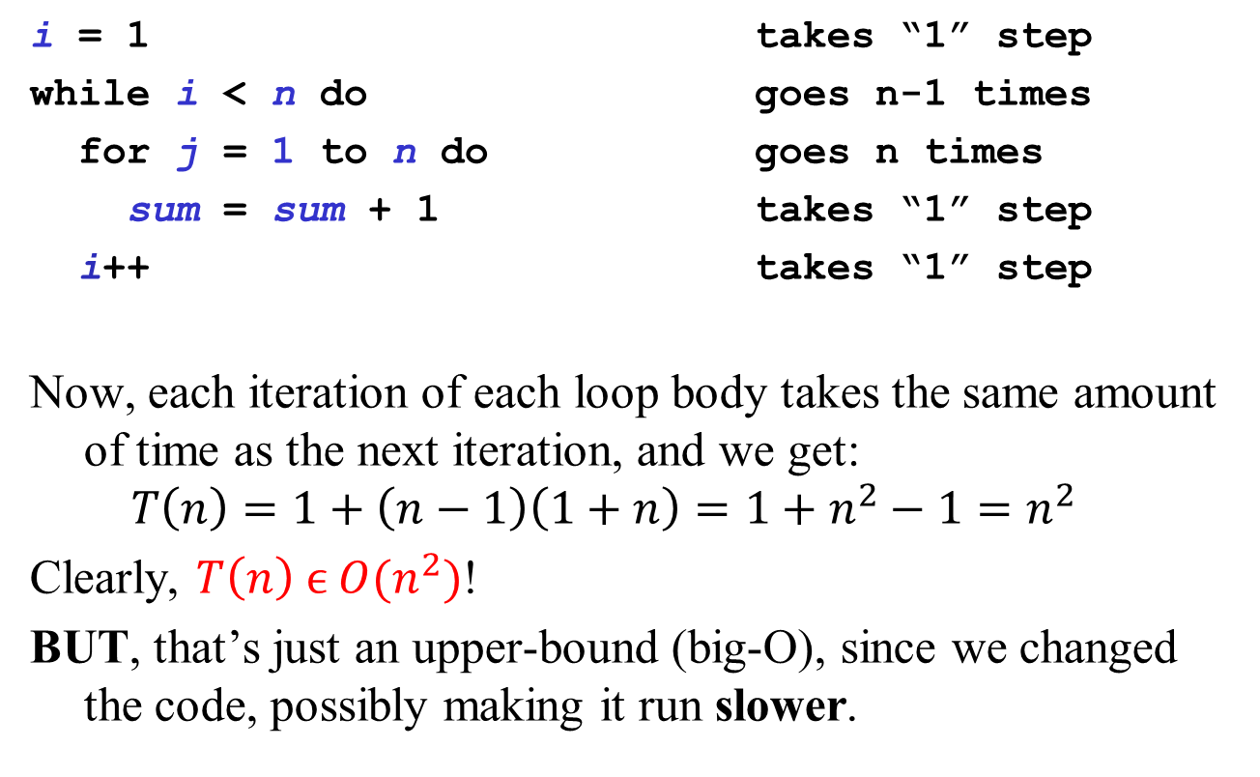
Three METYCSSA2 Approaches: Faster Code/Slower Code
i = 1 takes “1” step
while i < n do goes n-1 times
for j = 1 to n do goes n times
sum = sum + 1 takes “1” step
i++ takes “1” step
Now, each iteration of each loop body takes the same amount of time as the next iteration, and we get:
$$T\left(n\right)=1+\left(n−1\right)\left(1+n\right)=1+n^{2}−1=n^{2}$$
Clearly, $T\left(n\right) ϵ O(n^{2})$!
BUT, that’s just an upper-bound (big-O), since we changed the code, possibly making it run slower.
Exercise!
Notes:
There’s a little twist here. J goes from I to N, not 1 to N.
So, let’s do the sums
inside is constant.
Next loop is sum I to N of 1 which equals N - I + 1
Outer loop is sum 1 to N of N - I + 1
That’s the same as
sum N to 1 of I
or N(N+1)/2
or O(N^2)

Slide 71
Three METYCSSA2 Approaches: Faster Code/Slower Code
i = 1 takes “1” step
while i < n do i varies 1 to n-1
for j = i to n do j varies i to n
sum = sum + 1 takes “1” step
i++ takes “1” step
Let’s do a lower-bound, in which case we can make the code run faster if we want. The trouble is that j starts at i. If it started at n – 1 , we wouldn’t have to worry about i… but we’d get an Ω(n) bound, which is lower than we’d like.
We can’t start j at something nice like n/2 because i grows larger than n/2. So, let’s keep i from growing so large!
Exercise!
Notes:
There’s a little twist here. J goes from I to N, not 1 to N.
So, let’s do the sums
inside is constant.
Next loop is sum I to N of 1 which equals N - I + 1
Outer loop is sum 1 to N of N - I + 1
That’s the same as
sum N to 1 of I
or N(N+1)/2
or O(N^2)

Slide 72
Three METYCSSA2 Approaches: Faster Code/Slower Code
i = 1 takes “1” step
while i < n/2 + 1 do goes n/2 times
for j = i to n do j varies i to n
sum = sum + 1 takes “1” step
i++ takes “1” step
We used n/2 + 1 so the outer loop will go exactly n/2 times.
Now we can start j at n/2 + 1, knowing that j will never get that large, so we’re certainly not making the code slower!
Exercise!
Notes:
There’s a little twist here. J goes from I to N, not 1 to N.
So, let’s do the sums
inside is constant.
Next loop is sum I to N of 1 which equals N - I + 1
Outer loop is sum 1 to N of N - I + 1
That’s the same as
sum N to 1 of I
or N(N+1)/2
or O(N^2)

Slide 73
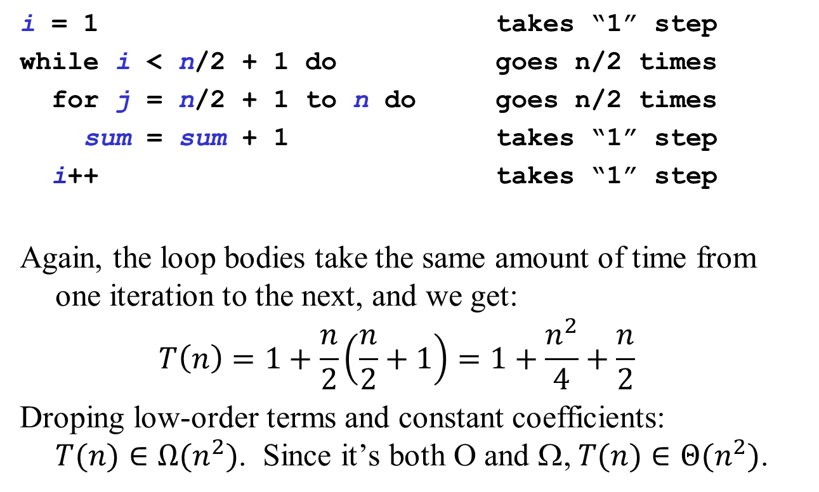

Three METYCSSA2 Approaches: Faster Code/Slower Code
$$T\left(n\right)∈Ω(n^{2})$$
Exercise!
Yay!!!
Notes:
There’s a little twist here. J goes from I to N, not 1 to N.
So, let’s do the sums
inside is constant.
Next loop is sum I to N of 1 which equals N - I + 1
Outer loop is sum 1 to N of N - I + 1
That’s the same as
sum N to 1 of I
or N(N+1)/2
or O(N^2)

Slide 74
Three METYCSSA2 Approaches: Pretty Pictures!
i = 1 takes “1” step
while i < n do i varies 1 to n-1
for j = i to n do j varies i to n
sum = sum + 1 takes “1” step
i++ takes “1” step
Imagine drawing one point for each time the gets executed. In the first iteration of the outer loop, you’d draw n points. In the second, n-1. Then n-2, n-3, and so on down to (about) 1. Let’s draw that picture…
Exercise!
Notes:
There’s a little twist here. J goes from I to N, not 1 to N.
So, let’s do the sums
inside is constant.
Next loop is sum I to N of 1 which equals N - I + 1
Outer loop is sum 1 to N of N - I + 1
That’s the same as
sum N to 1 of I
or N(N+1)/2
or O(N^2)

Slide 75
Three METYCSSA2 Approaches: Pretty Pictures!
* * * * * * * * * *
* * * * * * * * *
* * * * * * * *
* * * * * * *
* * * * * *
* * * * *
* * * *
* * *
* *
*
It’s a triangle, and its area is proportional to runtime
Exercise!
Notes:
There’s a little twist here. J goes from I to N, not 1 to N.
So, let’s do the sums
inside is constant.
Next loop is sum I to N of 1 which equals N - I + 1
Outer loop is sum 1 to N of N - I + 1
That’s the same as
sum N to 1 of I
or N(N+1)/2
or O(N^2)

Slide 76
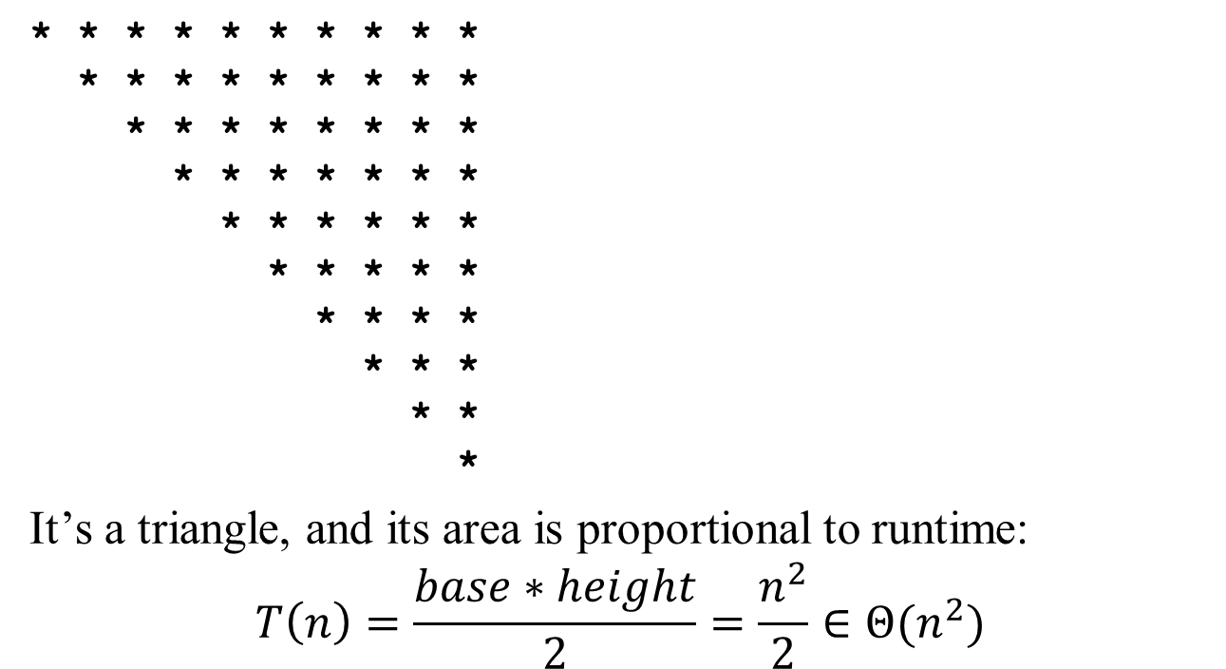
Three METYCSSA2 Approaches: Pretty Pictures!
about n columns
about n rows
Exercise!
Notes:
There’s a little twist here. J goes from I to N, not 1 to N.
So, let’s do the sums
inside is constant.
Next loop is sum I to N of 1 which equals N - I + 1
Outer loop is sum 1 to N of N - I + 1
That’s the same as
sum N to 1 of I
or N(N+1)/2
or O(N^2)

Slide 77
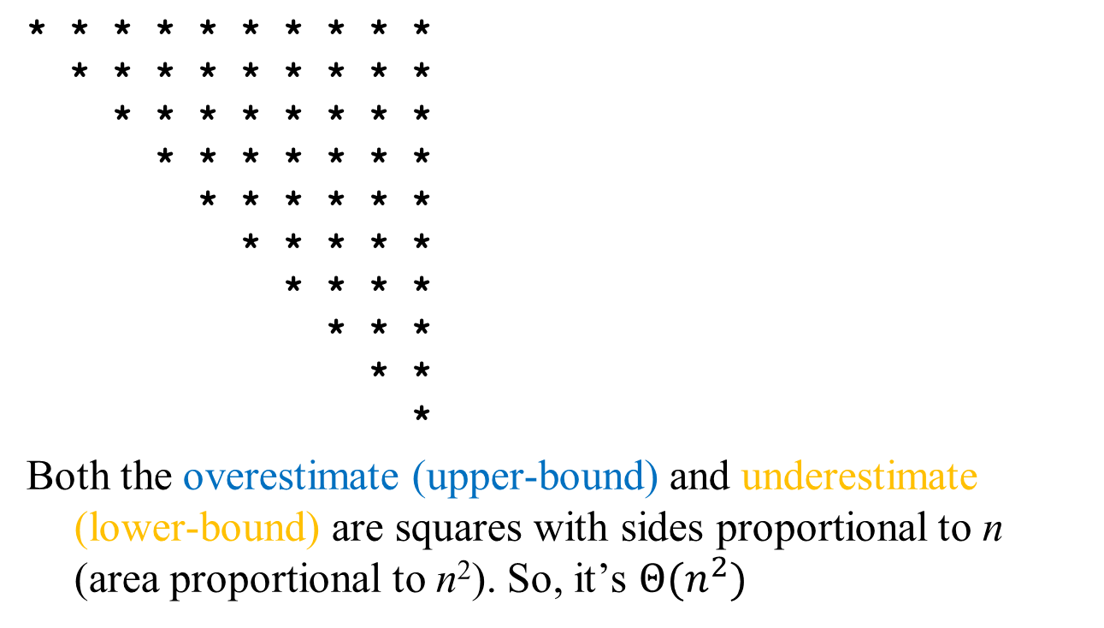
Note: Pretty Pictures and Faster/Slower are the Same(ish)
Exercise!
Notes:
There’s a little twist here. J goes from I to N, not 1 to N.
So, let’s do the sums
inside is constant.
Next loop is sum I to N of 1 which equals N - I + 1
Outer loop is sum 1 to N of N - I + 1
That’s the same as
sum N to 1 of I
or N(N+1)/2
or O(N^2)

Slide 78
METYCSSA (#3)
i = 1
while i < n do
for j = 1 to i do
sum = sum + 1
i += i
Time complexity:
O(n)
O(n lg n)
O(n²)
O(n² lg n)
None of these
Rule of thumb: Each nested loop adds one to n’s exponent.
But… that’s just a rule of thumb. Look at what code (like this!) does.
TRICKY exercise!
Notes:
Easy to think this might go n times through the first loop and n times through the second so we get O(n²). No such luck. Of course, O(n²) is correct as an upper-bound. It’s just not tight.
This sum is: S_0^floor(lg (n – 1)) S_1^(2^i) O(1)
Let’s just make O(1) into 1 for now; we can multiply by some constant c later if we want.
S_0^floor(lg(n-1)) 2^i
The sum of powers of 2 from 0 to k turns out to be 2^(k+1) – 1.
== 2^(floor(lg(n-1)) + 1) – 1
We can ditch the floor since this is a O analysis
== 2^lg(n-1)*2 – 1 == (n-1)*2 – 1 = 2n-2 = O(n)
Cool! ☺
This turns out to be a tight bound.

Slide 79
METYCSSA (#4)
Conditional
if C then S₁ else S₂
O(T(C) x (T(S1) + T(S2)))
Loops
while C do S
Do this one myself.
Notes:
OK, so this isn’t exactly an example. Just reiterating the rule.
Time <= time of C plus max of S1 and S2
<= time of C plus S1 plus S2
time <= sum of times of iterations
often #of iterations * time of S (or worst time of S)

Slide 80
METYCSSA (#5)
Recursion almost always yields a recurrence
Recursive max:
if length == 1: return arr[0]
else: return larger of arr[0] and max(arr[1..length-1])
T(1) <= b
T(n) <= c + T(n - 1) if n > 1
Analysis
T(n) <= c + c + T(n - 2) (by substitution)
T(n) <= c + c + c + T(n - 3) (by substitution, again)
T(n) <= kc + T(n - k) (extrapolating 0 < k ≤ n)
T(n) <= (n – 1)c + T(1) = (n – 1)c + b (for k = n - 1)
T(n) ∈
DO ON BOARD! Emphasize substitution.
Notes:
You may want to take notes on this slide as it just vaguely resembles a homework problem!
Here’s a function defined in terms of itself. You see this a lot with recursion. This one is a lot like the profile for factorial.
WORK THROUGH
Answer: O(n)

Slide 81
METYCSSA (#6): Mergesort
Mergesort algorithm
split list in half, sort first half, sort second half, merge together
T(1) <= b
T(n) <= 2T(n/2) + cn if n > 1
Analysis
T(n) <= 2T(n/2) + cn
<= 2(2T(n/4) + c(n/2)) + cn
= 4T(n/4) + cn + cn
<= 4(2T(n/8) + c(n/4)) + cn + cn
= 8T(n/8) + cn + cn + cn
<= 2^{k}T(n/2^{k}) + kcn (extrapolating 1 < k ≤ n)
<= nT(1) + cn lg n (for 2^{k} = n or k = lg n)
T(n) ∈
DO ON BOARD!
Notes:
This is the same sort of analysis as last slide.
Here’s a function defined in terms of itself.
WORK THROUGH
Answer: O(n log n)
Generally, then, the strategy is to keep expanding these things out until you see a pattern. Then, write the general form. Finally, sub in for the series bounds to make T(?) come out to a known value and solve all the series.
Tip: Look for powers/multiples of the numbers that appear in the original equation.

Slide 82
METYCSSA (#7): Fibonacci
Recursive Fibonacci:
int Fib(n)
if (n == 0 or n == 1) return 1
else return Fib(n - 1) + Fib(n - 2)
Lower bound analysis
T(0), T(1) >= b
T(n) >= T(n - 1) + T(n - 2) + c if n > 1
Analysis
let φ be (1 + √5)/2 which satisfies φ² = φ + 1
show by induction on n that T(n) >= bφ^{n - 1}
Would NOT expect you to do this w/out big hint!
Notes:
There’s no reason that people should have guessed phi’s involvement, but given these properties, asking about an induction problem like this wouldn’t be unreasonable.
(Should also be doable to develop looser bounds, though I haven’t double-checked that!)

Slide 83
Example #7 continued
Basis: T(0) ≥ b > bφ⁻¹ and T(1) ≥ b = bφ⁰
Inductive step: Assume T(m) ≥ bφ^{m - 1} for all m < n
T(n) ≥ T(n - 1) + T(n - 2) + c
≥ bφ^{n-2} + bφ^{n-3} + c
≥ bφ^{n-3}(φ + 1) + c
= bφ^{n-3}φ² + c
≥ bφ^{n-1}
T(n) ∈ Omega(phi^n)
Why? Same recursive call is made numerous times.

Slide 84
Example #7: Learning from Analysis
To avoid recursive calls
store all basis values in a table
each time you calculate an answer, store it in the table
before performing any calculation for a value n
check if a valid answer for n is in the table
if so, return it
This strategy is called “memoization” and is closely related to “dynamic programming”
How much time does this version take?

Slide 85
Abstract Example (#8): It’s Log!
Problem: find a tight bound on T(n) = lg(n!)
Time complexity:
O(n)
O(n lg n)
O(n²)
O(n² lg n)
None of these
Notes:
(Note: cut the two-variable example.)
Converting to a sum and then doing some clever splitting in half will get us there.
Student also suggested shortcutting the sum conversion and bounding by n^n inside the log. Good approach! Can do (n/2)^(n/2) inside as well.

Slide 86
Log Aside
log_{a}b means “the exponent that turns a into b”
lg x means “log₂x” (our usual log in CS)
log x means “log₁₀x” (the common log)
ln x means “log_{e}x” (the natural log)
But… O(lg n) = O(log n) = O(ln n) because: log_{a}b = log_{c}b / log_{c}a (for c > 1)
so, there’s just a constant factor between log bases

Slide 87
Asymptotic Analysis Summary
Determine what characterizes a problem’s size
Express how much resources (time, memory, etc.) an algorithm requires as a function of input size using O(•), Ω(•), Θ(•)
worst case
best case
average case
common case
overall???
IT DEPENDS
Notes:
Can anyone tell me what the right analysis to use for the overall case is?
IT DEPENDS!

Slide 88
Some Well-Known Horses from the Downs
For general problems (not particular algorithms):
We can prove lower bounds on any solution.
We can give example algorithms to establish “upper bounds” for the best possible solution.
Searching an unsorted list using comparisons: provably Ω(n), linear search is O(n).
Sorting a list using comparisons: provably Ω(n lg n), mergesort is O(n lg n).

Slide 89
Aside: Who Cares About Ω(lg (n!))? Can You Beat O(n lg n) Search?
Chew these over:
How many values can you represent with n bits?
Comparing two values (x < y) gives you one bit of information.
There are n! possible ways to reorder a list. We could number them: 1, 2, …, n!
Sorting basically means choosing which of those reorderings/numbers you’ll apply to your input.
How many comparisons does it take to pick among n! different values?

Slide 90
Some Well-Known Horses from the Downs
Searching and Sorting: polynomial time, tractable
Traveling Salesman Problem: non-deterministic polynomial… can check a guess in polynomial time, maybe exponential time to solve.
Are problems in NP really in P? $1M prize to prove yea or nay.
Notes:
Right-hand image from paper: Craig S. Kaplan and Robert Bosch. TSP Art. In Renaissance Banff: Bridges 2005: Mathematical Connections in Art, Music and Science, pages 301-308, 2005. Fair use (and Craig knows I’m talking about his stuff).
Don’t have source for left-hand ☹

Slide 91
Some Well-Known Horses from the Downs
Searching and Sorting numbers: P, tractable
Traveling Salesman Problem: NP, intractable
Halting Problem: uncomputable
Halting Problem: Does a given program halt on a given input. Clearly solvable in many (interesting) cases, but provably unsolvable in general.
(We can substitute “halt on” for almost anything else interesting: “print the value 7 on”, “call a function named Buhler on”, “access memory location 0xDEADBEEF on”, …)
Notes:
The text at the bottom is effectively the Berry Paradox, described by Russell, according to Wikipedia.

Slide 92
To Do
Find a teammate for labs and assignments (not necessarily the same!)
Keep up with the quizzes and programming projects!
Read Epp 9.2-9.3 (3rd ed.) or 11.2-11.3 (4th ed.) and Koffman 2.6
Prepare for upcoming labs
Notes:
TODO (future terms): update to do items!

Slide 93
Coming Up
Recursion and Induction
Loop Invariants and Proving Program Correctness
Call Stacks and Tail Recursion
First written corrections due
First Programming Project due
Notes:
TODO (future terms): update “coming up” items

